Slide 1
Ready, Set, Kindergarten!
Principal: Alexa Trafficante
Alexa.Trafficante@hcps.net
Assistant Principal: Raymond Spear Raymond.Spear@hcps.net
Notes:
© Copyright Showeet.com

Slide 2
Hillsborough County School Fast Facts!
Seventh largest school district in the nation
Elementary K-5 ..............142
Middle 6-8...................... 43
High 9-12.........................27
K-8.................................. 3
Total PreK – 12 students.......208,477

Slide 3
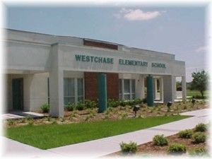
Westchase Elementary School
Preparing Students for Life!

Slide 4
Points of Pride
An “A” School since 2000!
Dedicated Teachers
Motivated Students
Amazing PTA

Slide 5
Your child’s success depends on…
GOOD ATTENDANCE!
Children who are present on the first day of kindergarten miss an average of 9 days of kindergarten. Children who are absent on the first day of kindergarten miss an average of 18 days of kindergarten.
Children who are absent for 18 or more school days in kindergarten have the lowest academic performance in 1st grade.
The Key to Success… Show Up! All Day, Every Day and ON TIME!

Slide 6
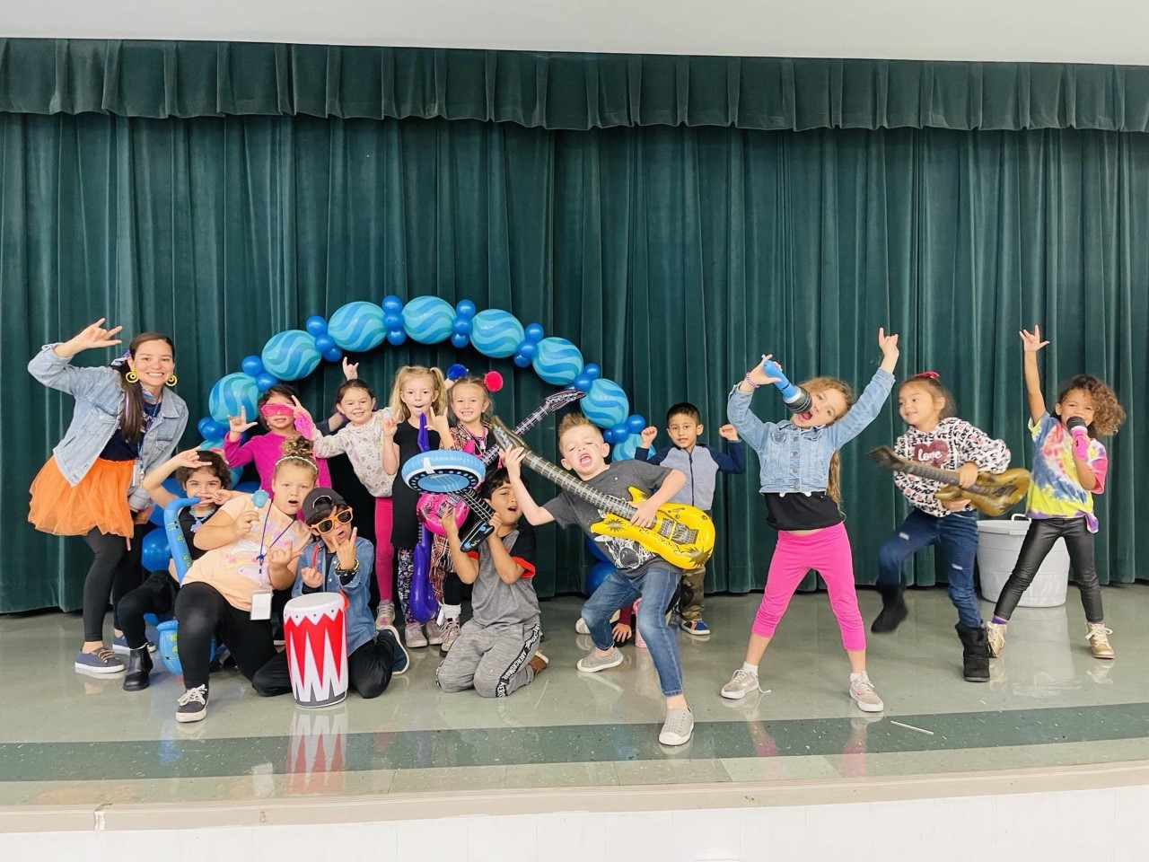
Your child’s success depends on…
Behavior that promotes learning
Participation in the classroom family
Active listening throughout the day
Responsibility (getting work done)
Independence
Effort
Self-sufficiency in the restroom

Slide 7
What is Expected of You!
Encourage positive behavior and relationships
Create independence
Review agendas/daily work together
Read with or to your child every night
Complete on-line Y.E.S application if volunteering at school
Make sure the teacher knows how your child will be going home (bus, car, walking, private provider van) and notify the office and teacher in writing of any changes
Make sure the office always has your current phone numbers, address, emergency contact, and email address.
Ensure your child arrives at school on time
School begins at 7:40am
Monday Early Release Dismissal 12:55pm
Tuesday – Friday Dismissal 1:55pm
Notify us immediately if you have any concerns

Slide 8
Uniforms
Currently a non-uniform school
Voted on each year

Slide 9
Our Kindergarten Team
2022-2023
Current Kindergarten Teachers:
Mrs. Scaglione
Mrs. Rodriguez
Mrs. Van Eerde (team leader)
Ms. Wafford
Mrs. Blanco
Mrs. Stone
Ms. Betancourt (Dual Language- Spanish)
Mrs. Rotondo (Dual Language- English)

Slide 10
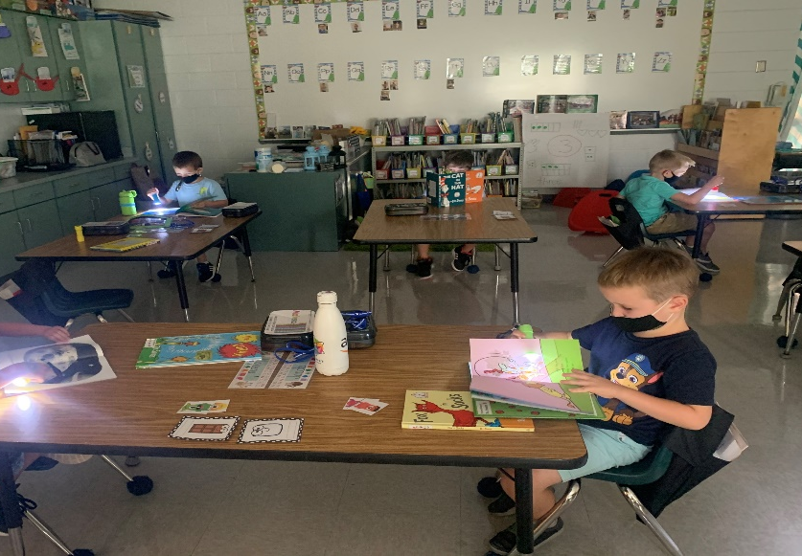
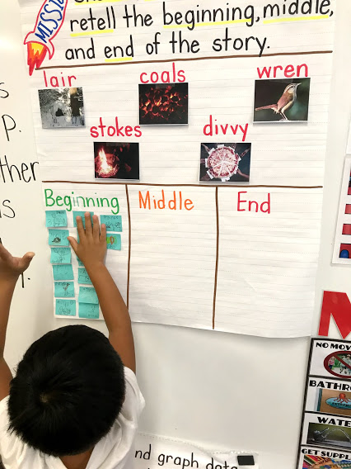
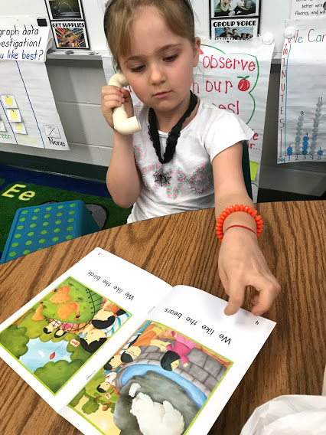
Reading
Read alouds
Shared big books
Interactive read alouds
Guided small groups
Independent Practice

Slide 11
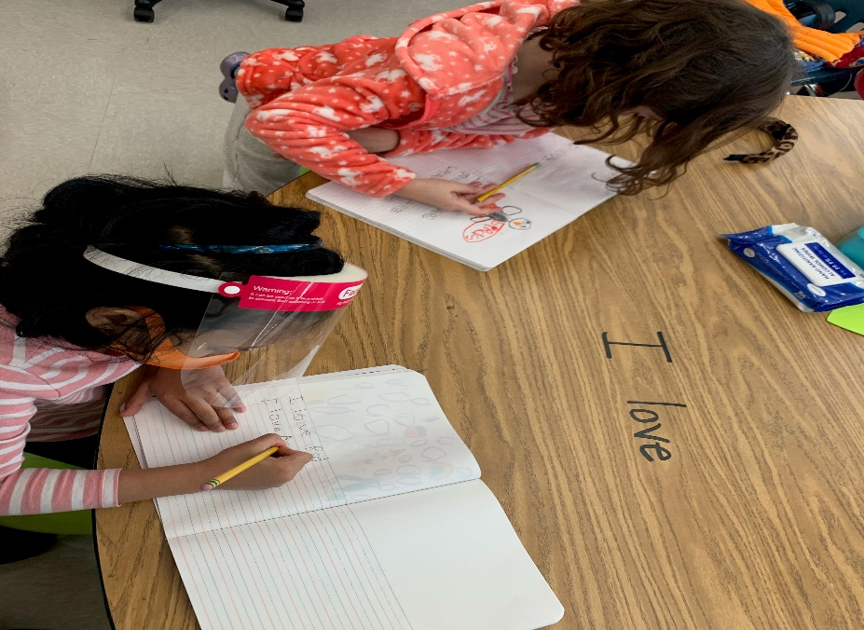
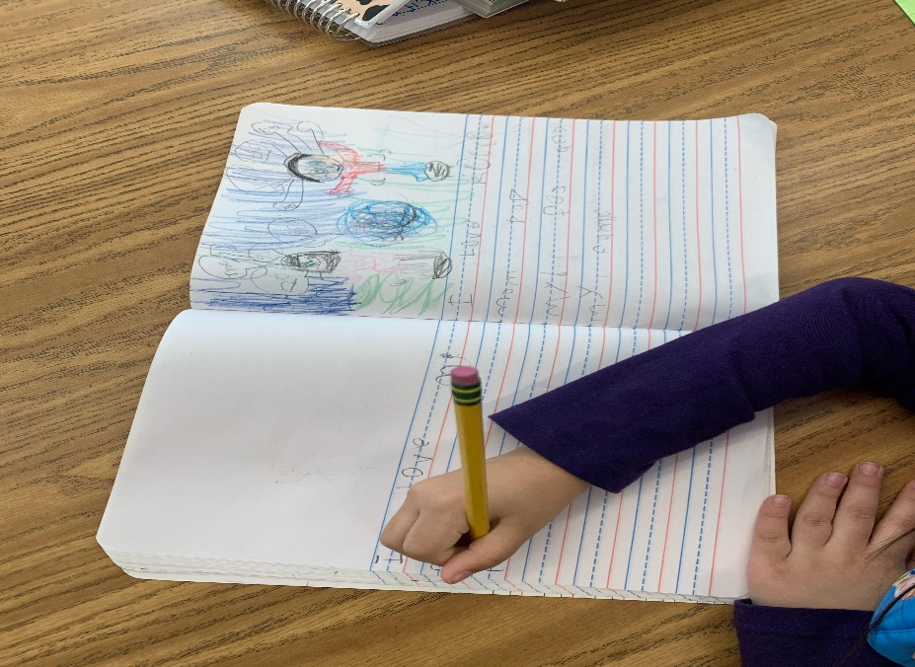
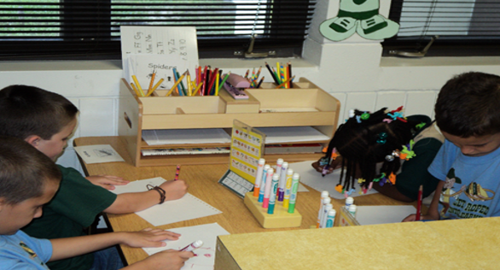
Writing
Modeled
Shared
Guided
Independent

Slide 12
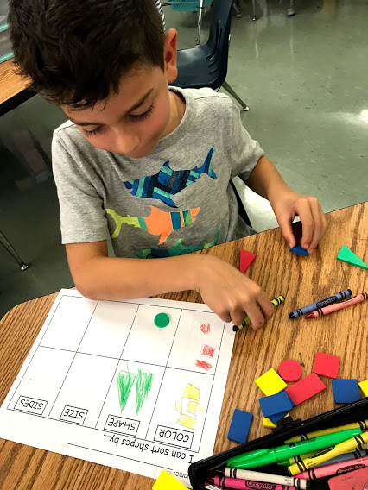
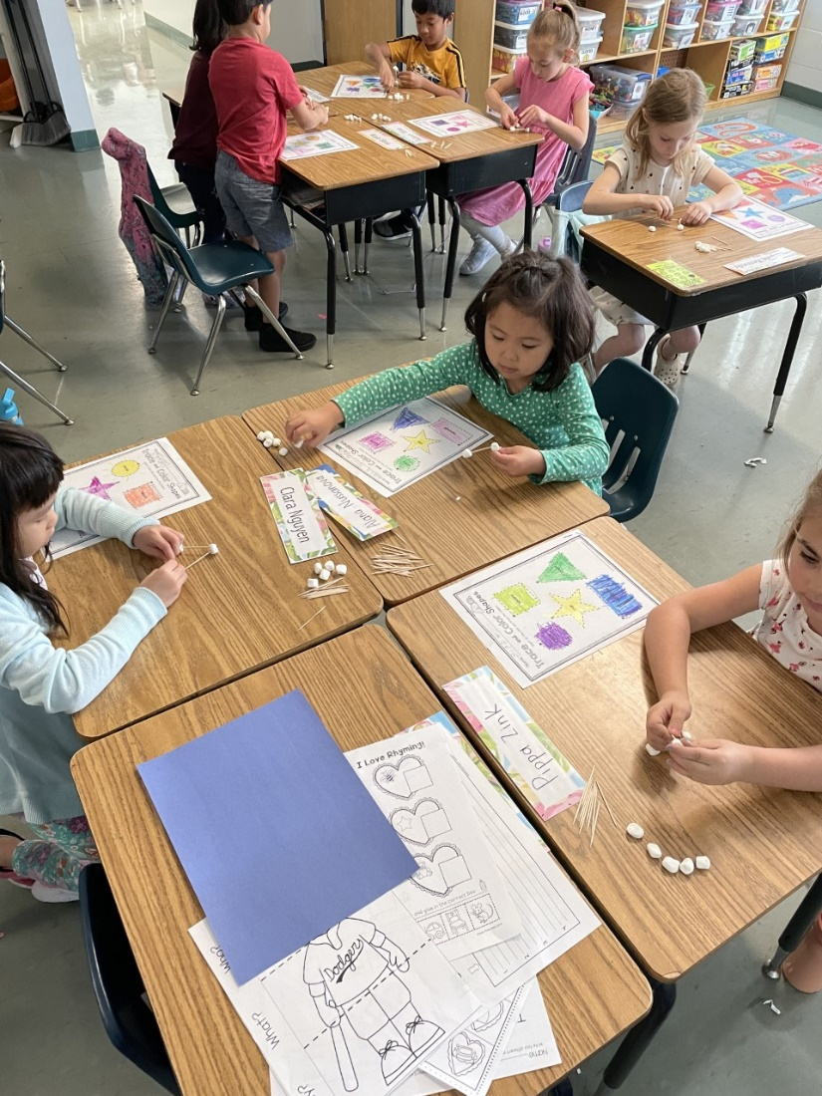
Math
Hands-on activities to deepen understanding

Slide 13
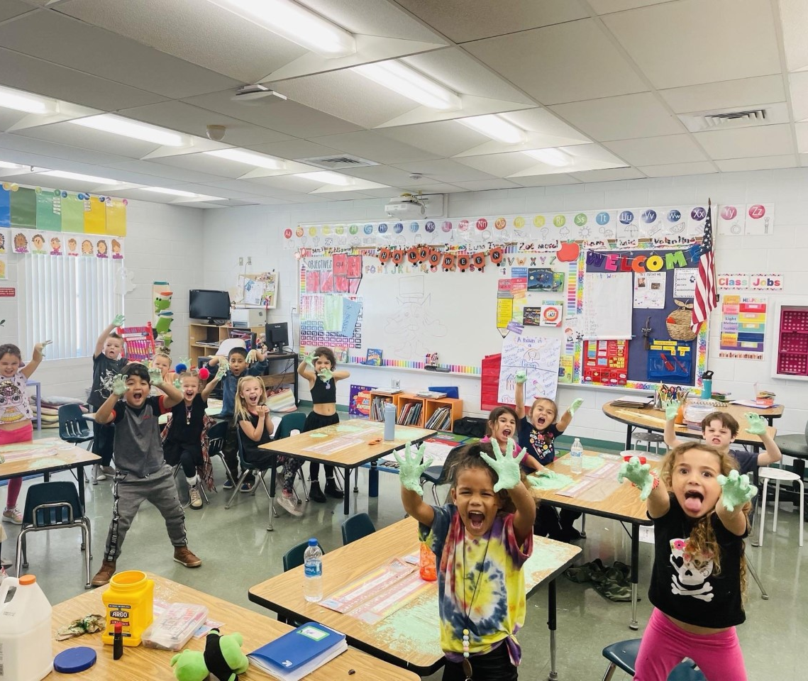
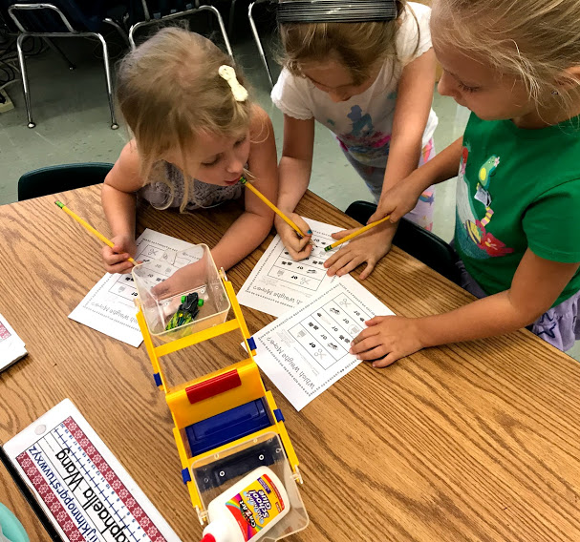
Science
STEM Challenge Activities
Hands-on, collaborative inquiry for deeper understanding

Slide 14
Social Studies
Calendars, Weather, Holidays, and American Heroes
Rules and Laws, Good Citizens
Jobs and Money, Wants and Needs, Families
Maps and Globes, Symbols of America

Slide 15
Mrs. Carmen Brinda – Data Processing Clerk
Registration Requirements
You MUST have all the following for your registration to be complete:
Child must be 5 on or before September 1st, 2023
Original Birth Certificate
Social Security Card
Current Physical (within 1 year of first day of school)
Immunization Record
2 Proofs of Address
See reference sheet in your folder or online for acceptable forms

Slide 16
Kriersten Rivenburg & Melanie Rosado School Counselors Taylor Strand – School Social Worker Angela Nertney – School Psychologist
School-wide discipline plan
School Counseling services
Social work services
Psychological services

Slide 17
Mrs. Hall – RN
Entry Vaccinations and Physicals
Medications
Medical Conditions
Clinic
Nutrition
Sleep
Hearing and Vision Screening
Tina.Hall@hcps.net

Slide 18
Gabrielle Giacobbe – ESE Contact Carly Deegan – Speech/Language
Childfind (before child is registered)
Developmental Screenings (3-5 years old) 813-837-7723
Current Individual Education Plan
From Florida or out of state
Bring a copy with you to registration
Communication in the Classroom
MTSS Process

Slide 19
Iliam Martell - Lunchroom Manager
Student numbers
Universal Breakfast
Free for all students
Served between 7:10 - 7:35 a.m.
Free and Reduced Lunch
Forms available upon registration/online registration available
Current lunch price is $2.25 (2023-2024 prices are subject to change)
Payment options: Online Payment is available through My Payments Plus

Slide 20
Emily Oquendo – English Language Learner Resource
SER form – Home Language Survey section
Screeners
Small Group Instruction for children who speak other languages

Slide 21
Dual Language Program
A program that fosters the development of a students’ oral, written and reading proficiency in two languages.
Students in the Dual Language program are on a pathway to biliteracy with the goal of attaining the prestigious Florida State Seal of Biliteracy upon high school graduation.

Slide 22
Mrs. Jessica Siddle – PTA President
Regularly scheduled events
First event planned for next year
How to join
Ways you can help

Slide 24
Summer VPK Program
FREE Summer program to ensure kindergarten
readiness (dates and times to be determined)
Approximately 20 sites throughout the district Registration requirements: proof of birth, proof of residence and a shot record
Registration at open summer VPK sites TBD
Child must be eligible to start kindergarten August, 2023
(5 by September 1, 2023)
Child may not have attended a school-year VPK unless
you’d like to pay which is an option.
VPK Hotline: 813-272-4840

Slide 25
HOST
813-744-8941 Ext. 3

Slide 26
School Tours
Will be held from 9:00-9:30am
March 7 – March 9
March 28- March 30
April 4 – April 6
https://www.signupgenius.com/go/10C0449AAA922A2F85-westchase
If slots fill up quickly, we will add more! ☺

